Slide 1



Sustainable Supply Chain Performance Dashboard using Power BI

Slide 2

Learning Objectives
1. Understanding Sustainable Supply Chain Metrics
Define supply chain sustainability and its importance in business.
2. Data Collection & Preparation
Gather and clean sustainability-related data from multiple sources Transform raw data into a structured format for Power BI.
3. Power BI Fundamentals
Create a Power BI dashboard with sustainability-related visualizations.
Design interactive reports with filters, slicers, and drill-throughs.
4. Data Visualization for Insights
Select appropriate visualizations (bar charts, KPIs, trend analysis, maps for carbon footprint tracking).
GOAL
Source :
www.freepik.com/

Slide 3
Learning Objectives
5. Analyzing and Interpreting Data
Perform trend analysis on sustainability KPIs.
Identify areas for improvement in the supply chain using data insights.
6. Automating and Sharing Reports
Automate data refresh and schedule reports in Power BI Service.
Share dashboards with key stakeholders for decision-making.
GOAL
Source :
www.freepik.com/

Slide 4
Tools and Technology used:
Power BI
Power BI is used to create a Sustainable Supply Chain Performance Dashboard by integrating data from databases.
It enables real-time visualization of sustainability KPIs like Shipping Costs, Shipping Times, Supplier Name, Product Type with how much amount of product sold in different cities, and there Supplier names more efficient supply chain.

Slide 5
Methodology
The methodology follows a structured approach to collect, process, analyze, and visualize supply chain sustainability data. The key steps include:
1. Requirement Analysis & KPI Identification
Define business objectives and sustainability goals.
2. Data Collection & Integration
Gather data from databases (Excel, CSVs)
Use Power Query for ETL (Extract, Transform, Load) to clean and structure data.
3. Data Modeling & Calculation
Design a data model with relationships between sustainability-related datasets.
4. Dashboard Design & Visualization
Create interactive Power BI reports with charts, KPIs, and geographic heatmaps.

Slide 6
Methodology
5. Automation & Real-time Updates
Configure Power BI Gateway for automatic data refresh.
6. Security & Deployment
Share dashboards via Power BI Service for decision-making.
7. Performance Monitoring & Optimization
Refine the dashboard based on user feedback and regulatory requirements.

Slide 7
Problem Statement:
Sum of number of products sold by supplier name represented in pie chart.
Sum of number of products sold by routes with bar charts.
Average of shipping costs by routes using bar chart.
Sum of stock levels by supplier name represented in pie chart.
Average of shipping costs and average of shipping times by transportation modes using bar chart.
Sum of stock levels by products type with bar chart.
Sum of order quantities by products type with bar chart.
Average of shipping times and Average of shipping costs by products type in bar chart.

Slide 8
Solution:
The dashboard visualizes key supply chain metrics using Power BI.
Pie charts
Display product sales and stock levels by supplier.
Bar chart
Analyze products sold by routes, stock levels by product type, order quantities, and shipping costs. Shipping times and costs are compared across transportation modes and product types.

Slide 9
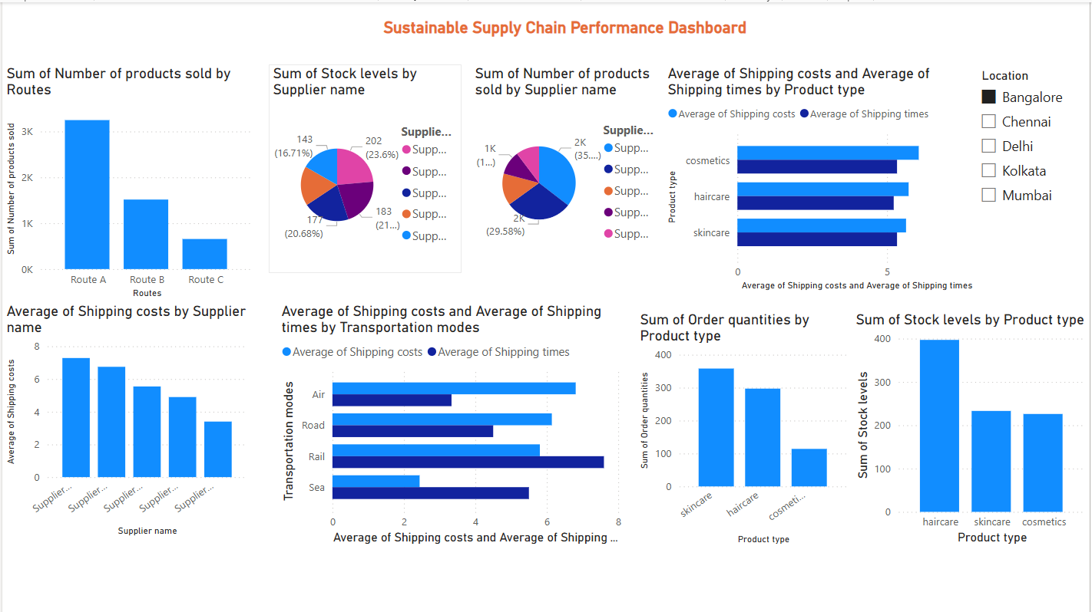
Screenshot of Output:

Slide 10
Conclusion:
The Sustainable Supply Chain Performance Dashboard in Power BI effectively visualizes key supply chain metrics, enabling data-driven decision-making. By integrating real-time data on product sales, stock levels, shipping costs, and transportation modes, businesses can optimize logistics, reduce costs, and enhance sustainability. This dashboard supports efficiency, transparency, and informed decision-making, aligning with sustainability goals.

